Slide 1
Data science
Session- 2
Date – 09th May, 2022

Slide 2
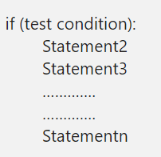
Python If Statement
The Python If statement is one of the most useful decisions making statements in real-time programming. Python If statement allows the compiler to test the condition first, depend upon the result, it executes the code block. while a given test condition is true, then only the code within the if block executes.
The if statement in Python Programming has a simple structure:
When the test condition in the Python If statement is true, Statement1, Statement2, ……., Statementn will execute. Otherwise, all too them will skip. Let us see the flow chart for a better understanding.

Slide 3
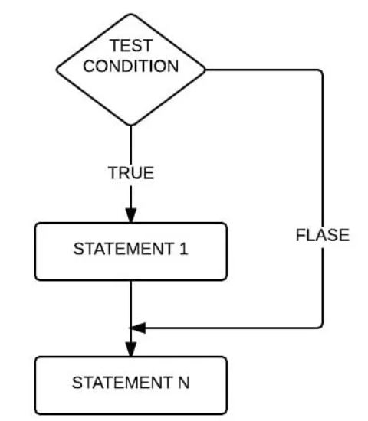
Python If Statement Flow Chart

Slide 4
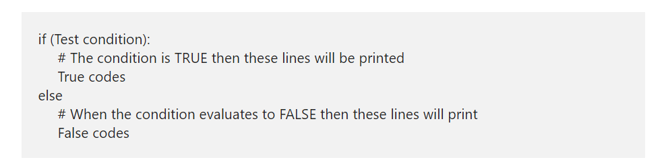
Python If Else Statement
The Python If Else Statement is an extension to the If (which we discussed in the earlier post). The If condition will only execute the code block when the given condition is true and when the condition is false, it will not execute the code.
In real-world, it would be nice to execute something when the expression fails. To do so, If condition is used and here, the Else block will run some code when the condition fails. The syntax of the Python If Else Statement is.
When the test condition present in the above Python If else structure is evaluated to true, True statements executed. When it return false, False code executed.

Slide 5
Python Nested If
Python Nested If Statement means to place one If inside another If Statement. Python If Else statement allows us to print different statements depending upon the expression result (TRUE, FALSE). Sometimes we have to check further even when the condition is TRUE. In these situations, we can use the Python Nested IF statements, but be careful while using it.
In the Python nested if statement example, every person is eligible to work if he is 18 years old or above. Else he is not qualified. However, companies won’t offer a job to every person. So, we use another If condition, also called Python Nested If Statement, to check his education qualifications or any specific company requirements.

Slide 6
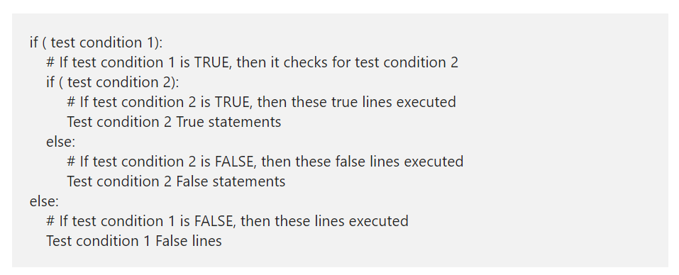
Python Nested If Statement Syntax
The Python Nested If Statement Syntax is

Slide 7
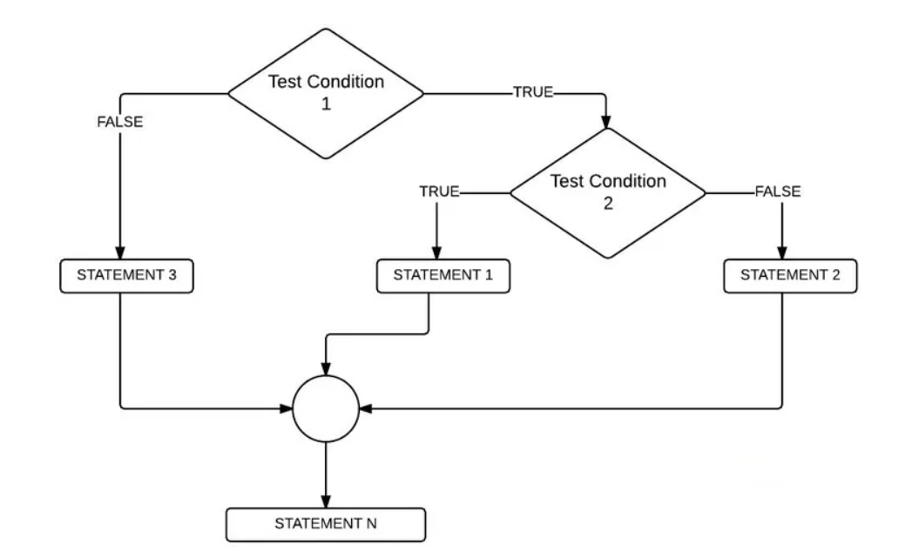
Nested if Flow Chart

Slide 8
Python elif Statement
The Python elif Statement also called as the Else If and it is very useful when we have to check several conditions. Apart from this Python elif, we can also use the Nested If to achieve the same. However, as the number of conditions increase, the Nested If else complexity will also increase. Let us see the syntax of the same.

Slide 9
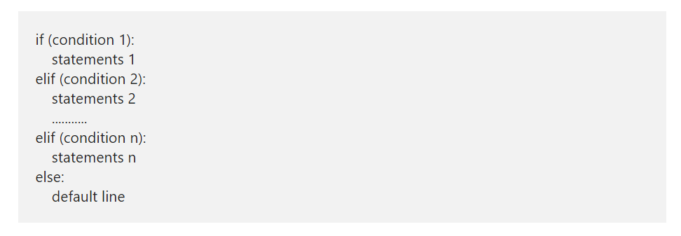
Python elif Syntax
The syntax of Python elif or else if statement is

Slide 10
Python elif Syntax Contd.
The Python Elif or else if statement handles multiple lines effectively by executing them sequentially. It means Python elseif or elif will check for the first condition, if the condition is TRUE then it will execute the statements present in that block.
If the condition is FALSE then Python elseif will check the Next one (Elif conditional statement) and so on. There will be some situations where condition 1, condition 2 is TRUE, for example:
x= 20, y=10
Condition 1: x > y # TRUE
Condition 2: x != y # TRUE
In these situations, block of code under the Condition 1 will be executed. Because Python elif conditions will only be executed if its previous if statement (else) fails.

Slide 11
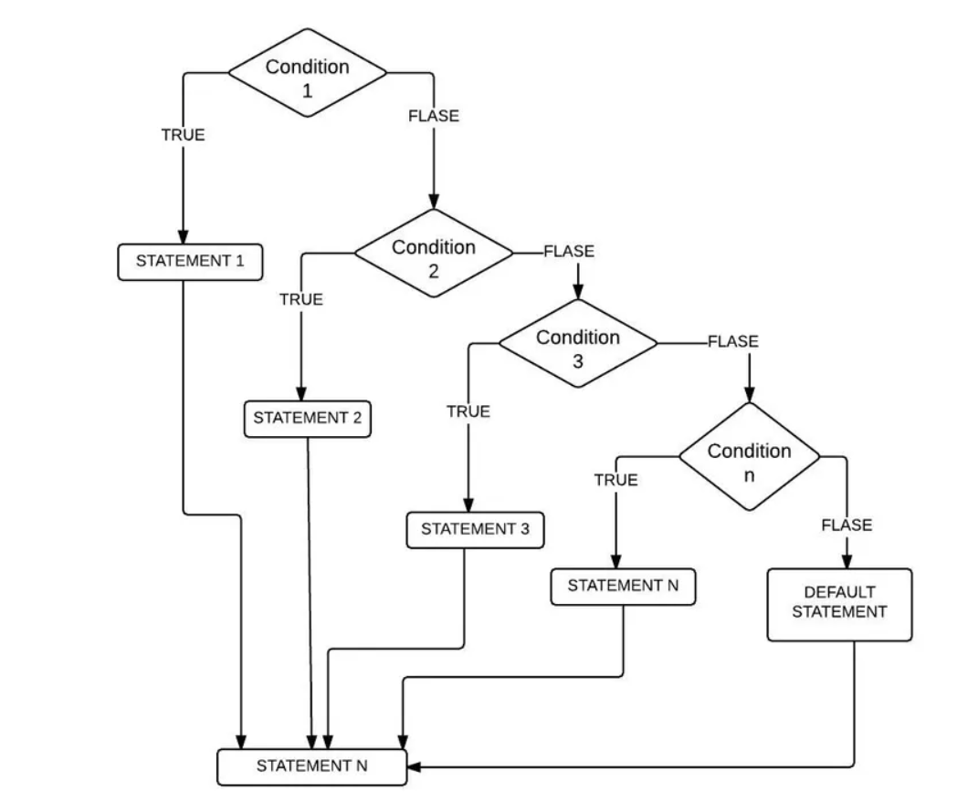
Elseif Statement Flow Chart

Slide 12
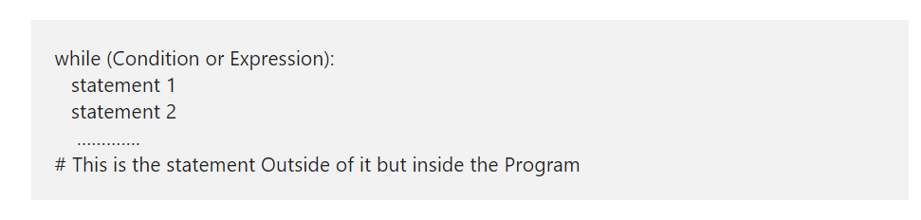
Python while Loop
The Python while Loop is used to repeat a block of statements for given number of times, until the given condition is False. A while loop in Python start with the condition, if the condition is True then statements inside it will be executed. If the given condition is false, it won’t execute at least once, which means, it may execute zero or more time and the syntax of it is:
The Python While Loop Syntax is as follows:

Slide 13
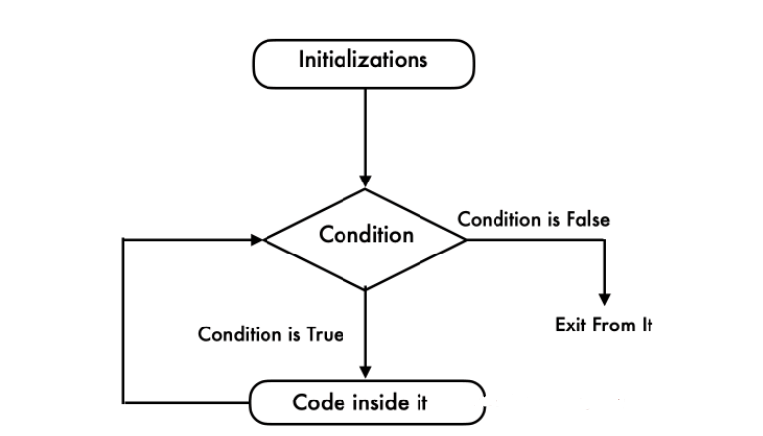
Python while Loop Flow Chart
This flow chart will explain you Visually and perfectly

Slide 14
Python while Loop Flow Chart Contd.
Python while loop will check for the condition at the beginning of it.
If the condition evaluates to True then it will execute the code inside it.
Next, we have to use Arithmetic Operator inside the Python while loop to increment and decrement the value.
After the value increments, it will again check the expression. As long as the condition is met, the statements in it will be executed.
If the expression becomes False then it will exit from it.

Slide 15
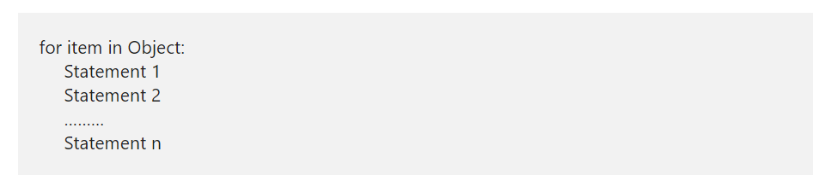
Python For Loop
The Python For Loop is used to repeat a block of statements until there are no items in the Object may be String, List, Tuple, or any other object. Let us see how to write the Python For Loop, range, and the else part with practical examples. Let us see the syntax of it, prior to getting into the details:
The syntax of the Python For Loop in is as follows:

Slide 16
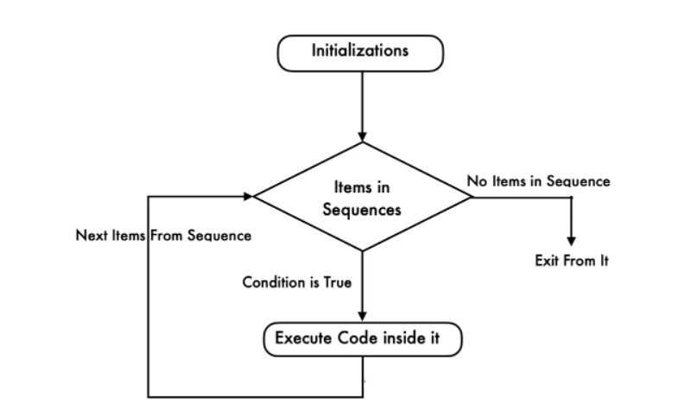
Python For Loop Flow Chart

Slide 17
Python For Loop Flow Chart Contd.
The execution process of the for loop in python is:
Initialization: We initialize the variable(s) here. Example i=1.
Items in Sequence / Object: Compiler will check the items in Objects. Example, individual letters in String word. If there are items in sequence ( True) then it will execute the statements within it or inside. If there is no item in sequence ( False) then it will exit.
After completing the current iteration, compiler will traverse to next item.
Again it will check the new items in sequence. As long as the items in sequence, the statements inside it will be executed.

Slide 18
Python break Statement
The Python break statement is very useful to exit from For, While and Nested Loops. While executing these code blocks, if the compiler finds this inside them, the compiler will stop executing the code inside it and exit immediately from the iteration.
For example, we have 5 lines of code inside the loop and we want to exit from it when certain condition is True otherwise, it has to execute them. In these situations we can place the Python Break statement inside the If condition.
If the condition is True then compiler will execute this statement. It means, the Python break Statement will exit the controller from the loop completely. Otherwise, it will execute all block of code.

Slide 19
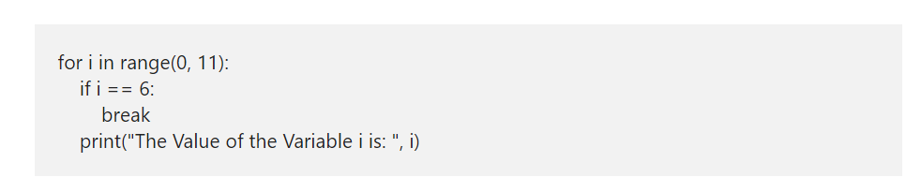
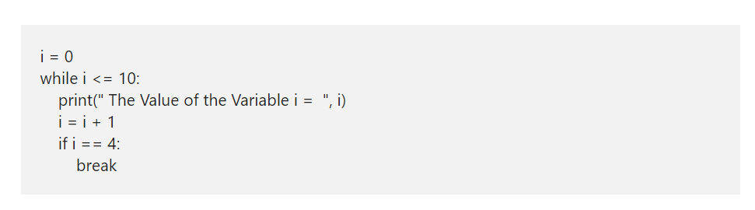
Python break Statement in For and While loop

Slide 20
Python continue
The Python continue statement is another one to control the flow of loops. Similar to Break statement, this Python continue statement is used inside For and While Loops. While executing these iterables, if compiler find this statement inside them, then compiler will stop the current iteration and starts the new iteration from the beginning.
For example, we have 10 statements inside the loop. And we want to skip executing the last 5 (statement6 — 10) when a certain condition is True or else it has to execute all the 10 statements inside a loop. In these situations, we place the condition after the 5th followed by the Python continue statement. If the condition is True then it will stop executing statement6 to 10 otherwise, it will execute lines 1 to 10.

Slide 21
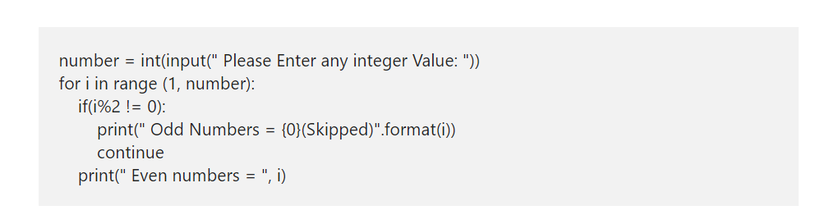
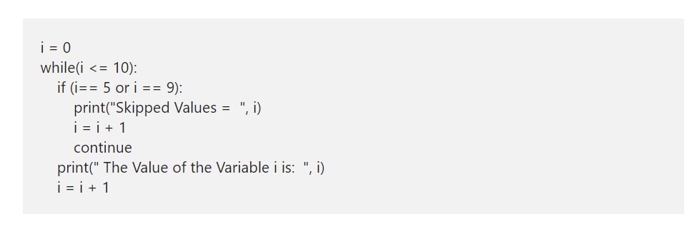
Python continue Syntax

Slide 22
What is a List in Python?
The Python List is one of the most useful sequences in real-time. A Python list is a sequence of multiple values in an ordered sequence. Unlike Strings, it allows us to store different types of data such as integer
An object that contains no values or elements is empty and placing a square bracket creates an empty list in python language.
ListName = []
IntegerList = [1, 2, 3, 4, 5]
StringList = [‘apple’, ‘Orange’, ‘Grape’, ‘Mango’]
MixedList = [‘apple’, 2, 3.50, ‘Mango’]
Python Lists sequentially store data (ordered). So, we can access the elements with the help of indexes. Moreover, using indexes, we can access or alter/change each item present in it separately. The syntax to access items is
ListName([IndexNumber])

Slide 23
Insert items into Python List
Append(x): The append method adds item x at the end.
Insert(i, x): The insert method inserts the specified item x at position i.
Extend(New_List): The extend method adds all the elements in New_List at the end.
Python List Slicing

Slide 24
More List Function
copy()
clear()
sort()
reverse()
index(element)
count(element)
sum(list)

